Slide 1
LOGISTICS MANAGEMENT
TEAM MEMBERS:
BAVADHARANI V (727822TUCS021)
DEVI MARIZHA P (727822TUCS030)
HARINI R (727822TUCS046)
JAI KARTHIK M (727823TUCS603)

Slide 2
DESCRIPTON:
Logistics management is fundamental to enabling businesses and organizations to operate efficiently and effectively. These skills involve planning, prioritizing, and executing logistics tasks within a specific timeframe to achieve desired goals and outcomes
Logistics Identification: Recognizing all the logistics activities that need to be completed.
Scheduling: Creating a timetable for when logistics tasks should be started and completed.
Goal Setting: Defining short-term and long-term objectives to guide logistics planning and execution.
Prioritization: Determining the order in which logistics tasks should be tackled based on their importance and urgency.
Tracking Progress: Monitoring the status of logistics activities to ensure they are on track.
Completion: Ensuring logistics tasks are finished to the required standard and on time.

Slide 3
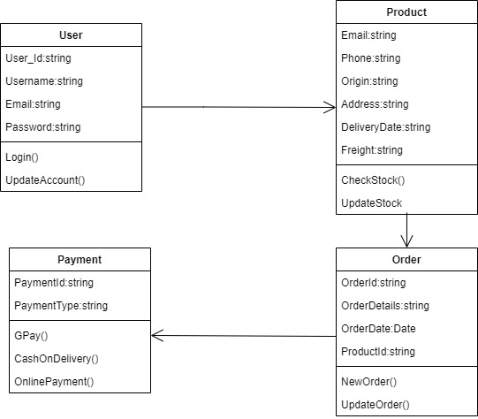
CLASS DIAGRAM :

Slide 4
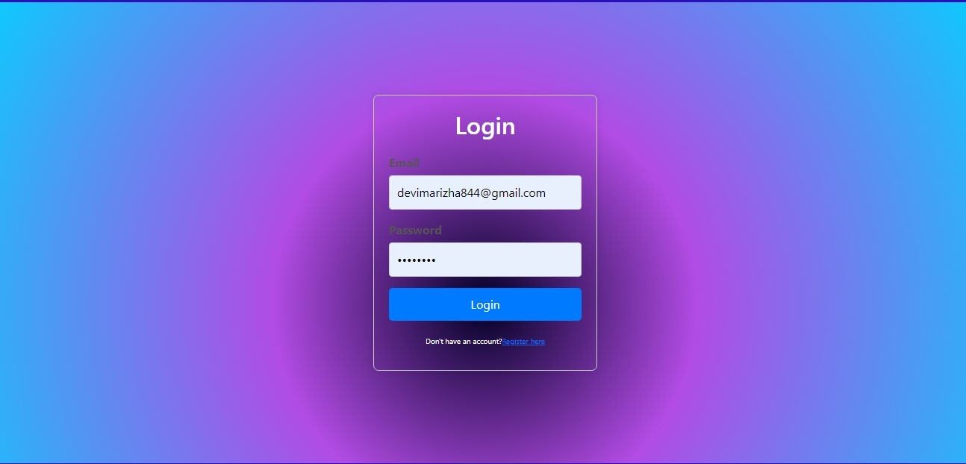
USER LOGIN :

Slide 5
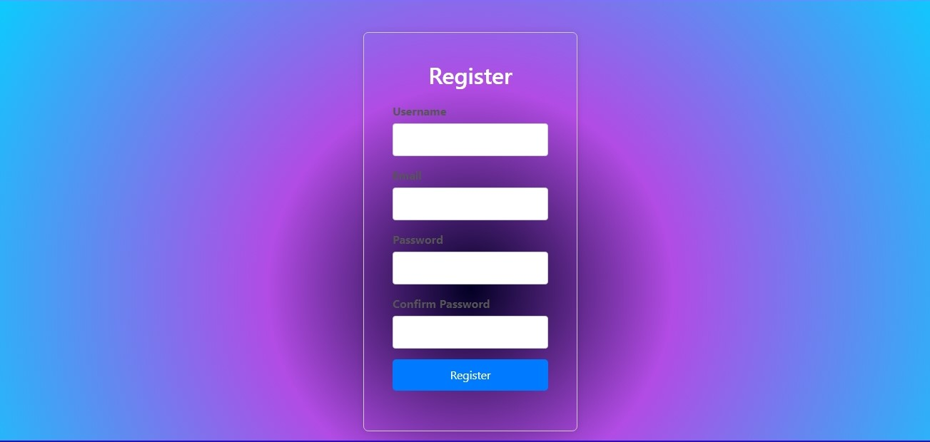
REGISTER PAGE:

Slide 6
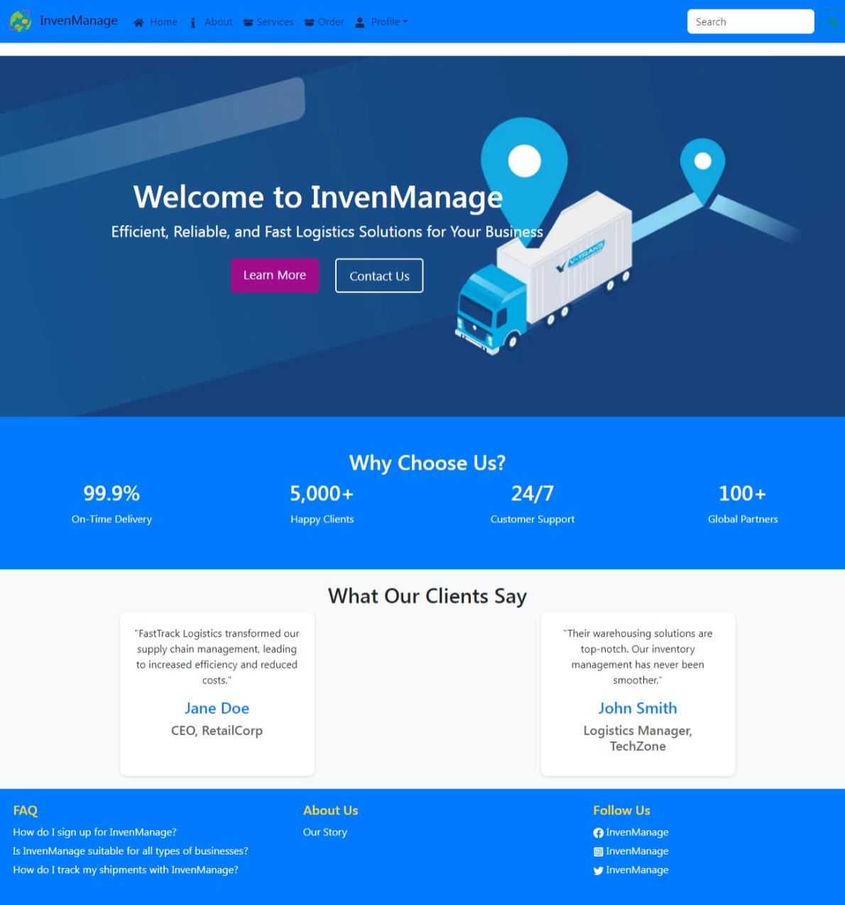
HOME PAGE:

Slide 7
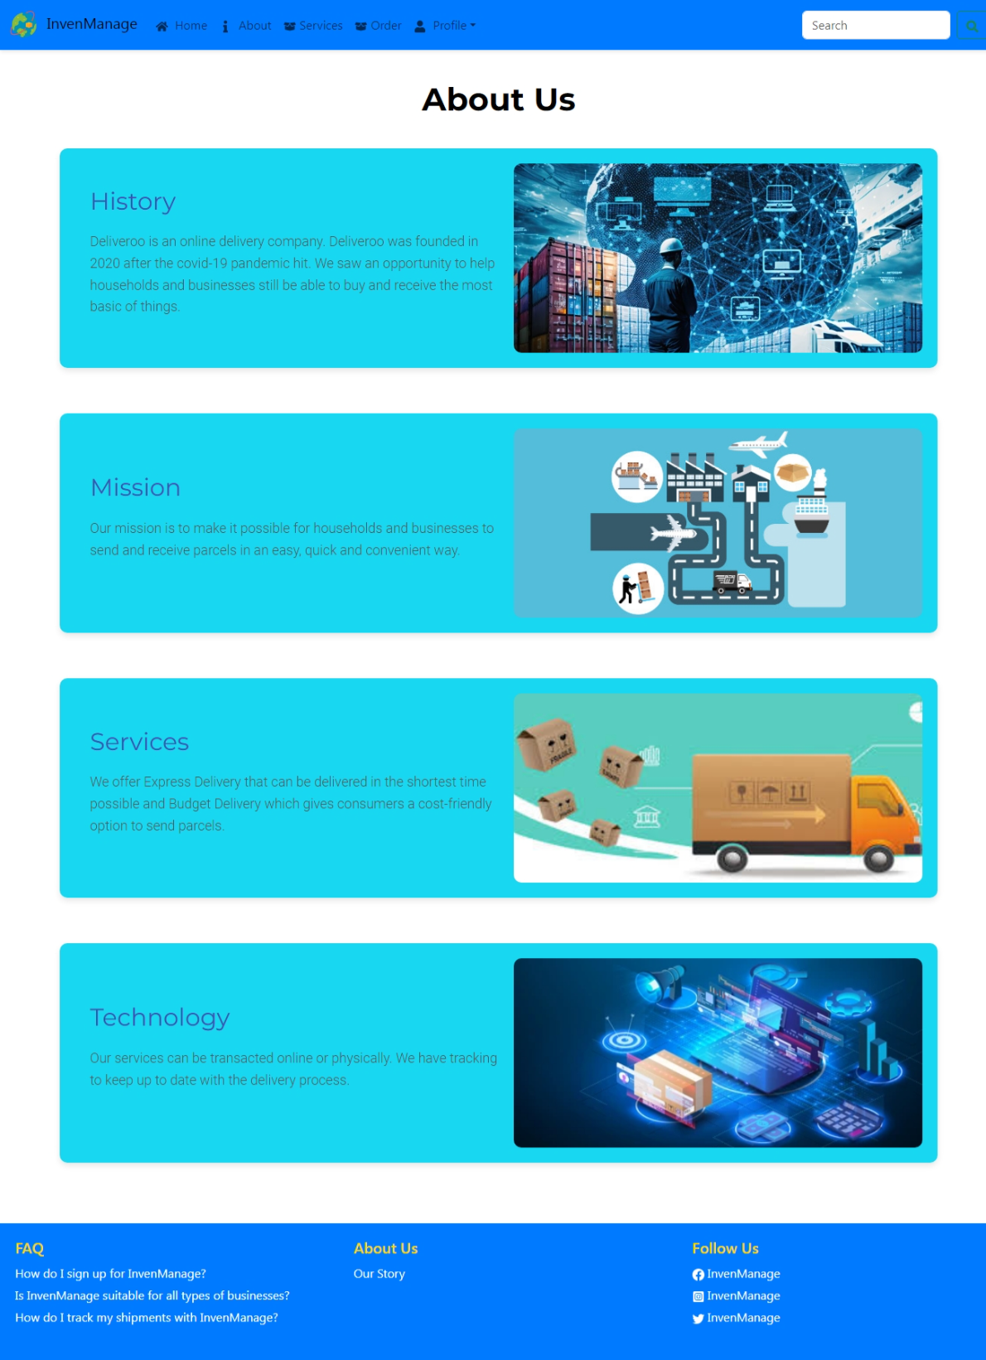
ABOUT PAGE:

Slide 8
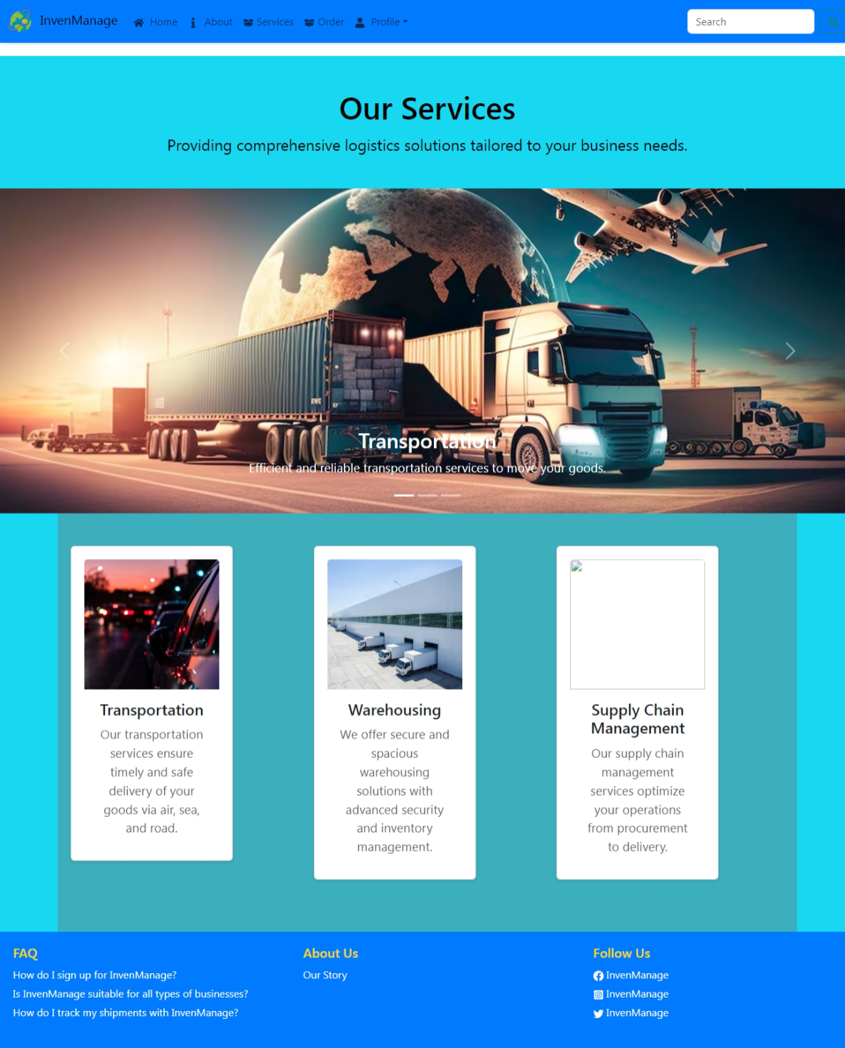
SERVICES PAGE:

Slide 9
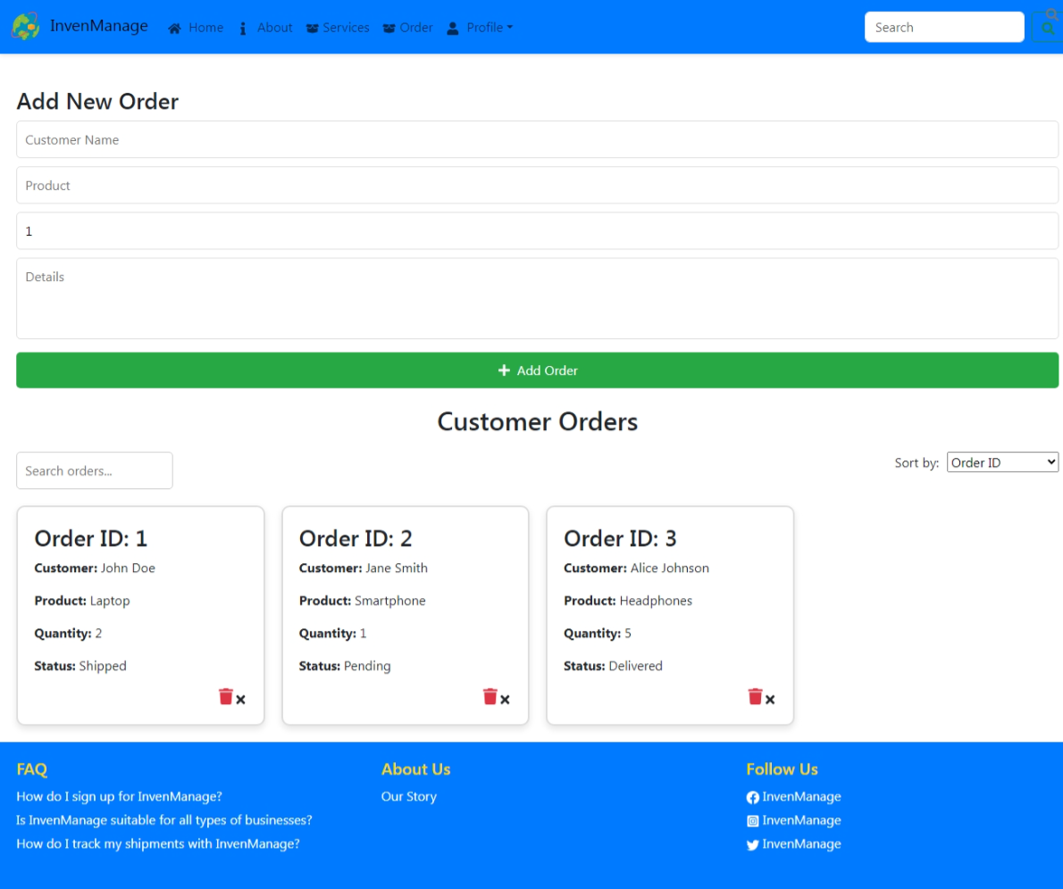
ORDER PAGE:

Slide 10
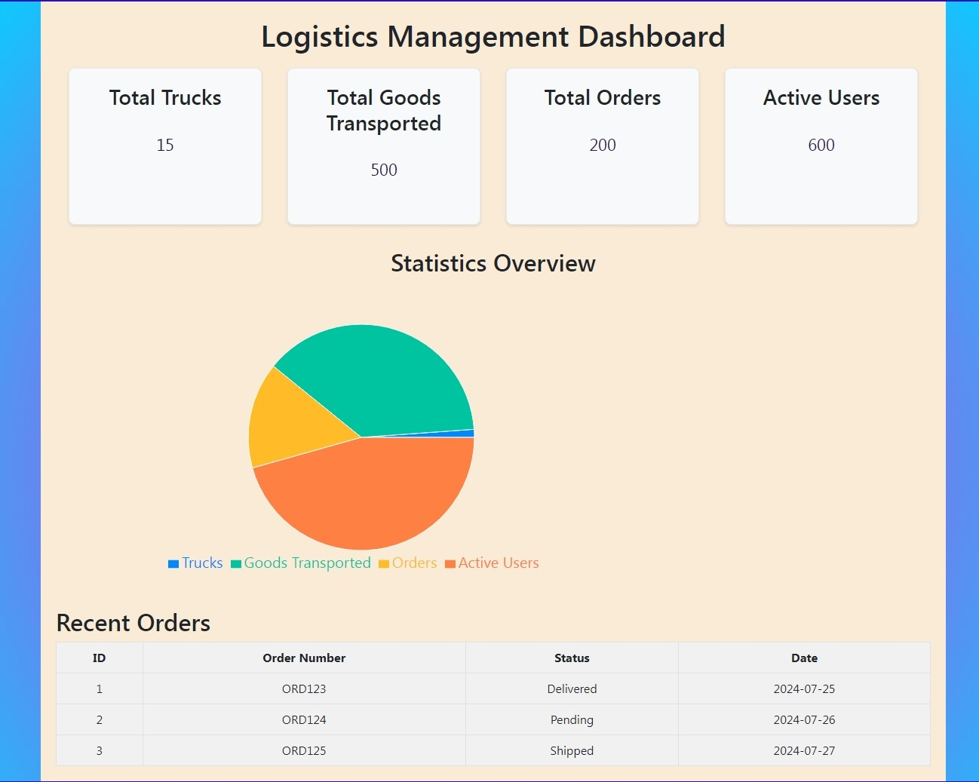
DASHBOARD:

Slide 11
THANK YOU!!!

